Slide 1



(Big Data) with Spark
Big data should be f(n)ctional)!
By- Achal Aggarwal & Syed Atif Akhtar
Notes:
just mention that we will be covering functional paradigm
Ask question - How many of you have wokred on BigData, we will stry to make fun for people who haven’t - pun intended.

Slide 2
Agenda
History of Big Data and Hadoop
What it looked like to be working on big data in the Stone Ages
Big Data world Explodes, Functional is the way to go!
Why functional made sense for Big Data
Peek into the world of functions
Spark is born, spark is functional, spark does everything!
Demonstrations
Back to the future again part 2,the sequel reborn!
Notes:
handover to Atif
Any guesses to what happened next?

Slide 3
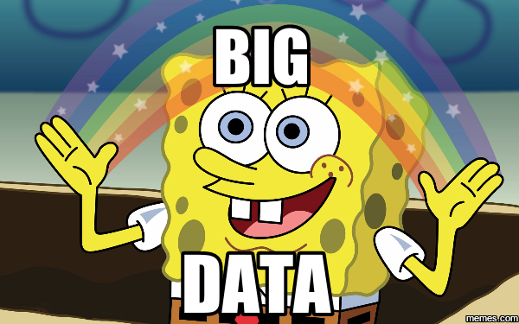
Notes:
Big data is big

Slide 4
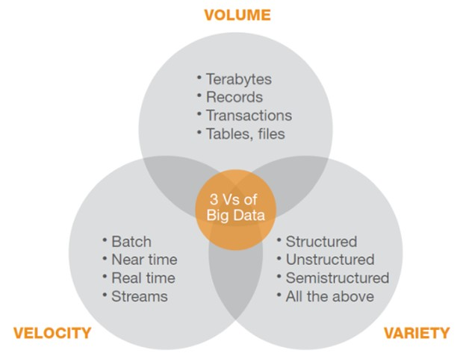
The 3 V’s revisited
Notes:
bakar

Slide 5
About Hadoop
Used for storage and large scale processing of data-sets on clusters of commodity hardware
Came out in 2004 - Doug Cutting
Based on a google paper in 2003
Open source framework
Mainly consists of the following two modules:
HDFS (Distributed Storage)
MapReduce (Analysis/Processing)
Notes:
handover to Achal
Any guesses to what happened next?

Slide 6

A brief tour into some historic code

Slide 7
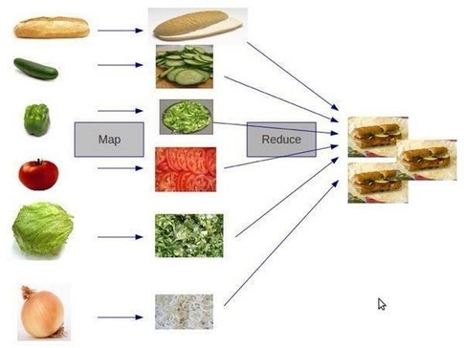
What is MapReduce?
Source: Quora

Slide 8
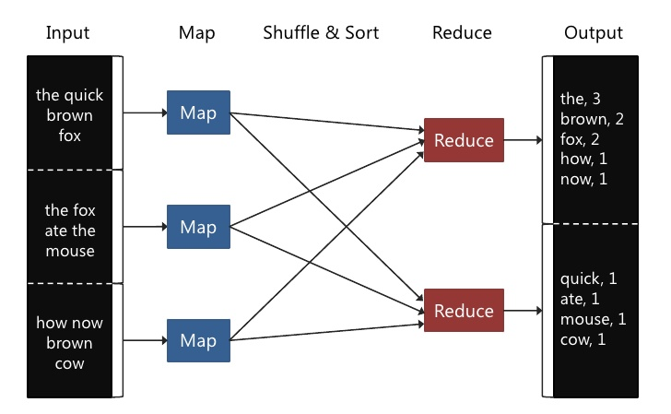
Word Count Example
Notes:
Can you guess what will these mapper do on the input and reducer’s implementation.

Slide 9
Word Count - Driver Program
public class WordCount {
public static void main(String[] args) throws Exception {
Configuration conf = new Configuration();
Job job = Job.getInstance(conf, "word count");
job.setJarByClass(WordCount.class);
job.setMapperClass(TokenizerMapper.class); //Mapper
job.setCombinerClass(IntSumReducer.class); // Reducer
job.setReducerClass(IntSumReducer.class); //Reducer
job.setOutputKeyClass(Text.class);
job.setOutputValueClass(IntWritable.class);
FileInputFormat.addInputPath(job, new Path(args[0]));
FileOutputFormat.setOutputPath(job, new Path(args[1]));
System.exit(job.waitForCompletion(true) ? 0 : 1);
}
Notes:
handover to Atif
Any guesses to what happened next?

Slide 10
Word Count - Mapper Program
public static class TokenizerMapper
extends Mapper<Object, Text, Text, IntWritable>{
private final static IntWritable one = new IntWritable(1);
private Text word = new Text();
public void map(Object key, Text value, Context context
) throws IOException, InterruptedException {
StringTokenizer itr = new StringTokenizer(value.toString());
while (itr.hasMoreTokens()) {
word.set(itr.nextToken());
context.write(word, one);
}
}
}
Notes:
handover to Atif
Any guesses to what happened next?

Slide 11
Word Count - Reducer Program
public static class IntSumReducer
extends Reducer<Text,IntWritable,Text,IntWritable> {
private IntWritable result = new IntWritable();
public void reduce(Text key, Iterable<IntWritable> values,Context context
) throws IOException, InterruptedException {
int sum = 0;
for (IntWritable val : values) {
sum += val.get();
}
result.set(sum);
context.write(key, result);
}
}
}
Notes:
handover to Atif
Any guesses to what happened next?

Slide 12
Problems in Hadoop Map Reduce
Composability and complexity
Not intuitive, everything needs to be broken down to very low level map-reduce phases
Huge development effort and time
Hard to debug and understand
Hard to optimize
Built primarily for batch jobs (Volume of data - not very good with variety/does not tackle velocity directly)
Everything happens on the storage layer
Notes:
handover to Atif
Any guesses what happened next?

Slide 13



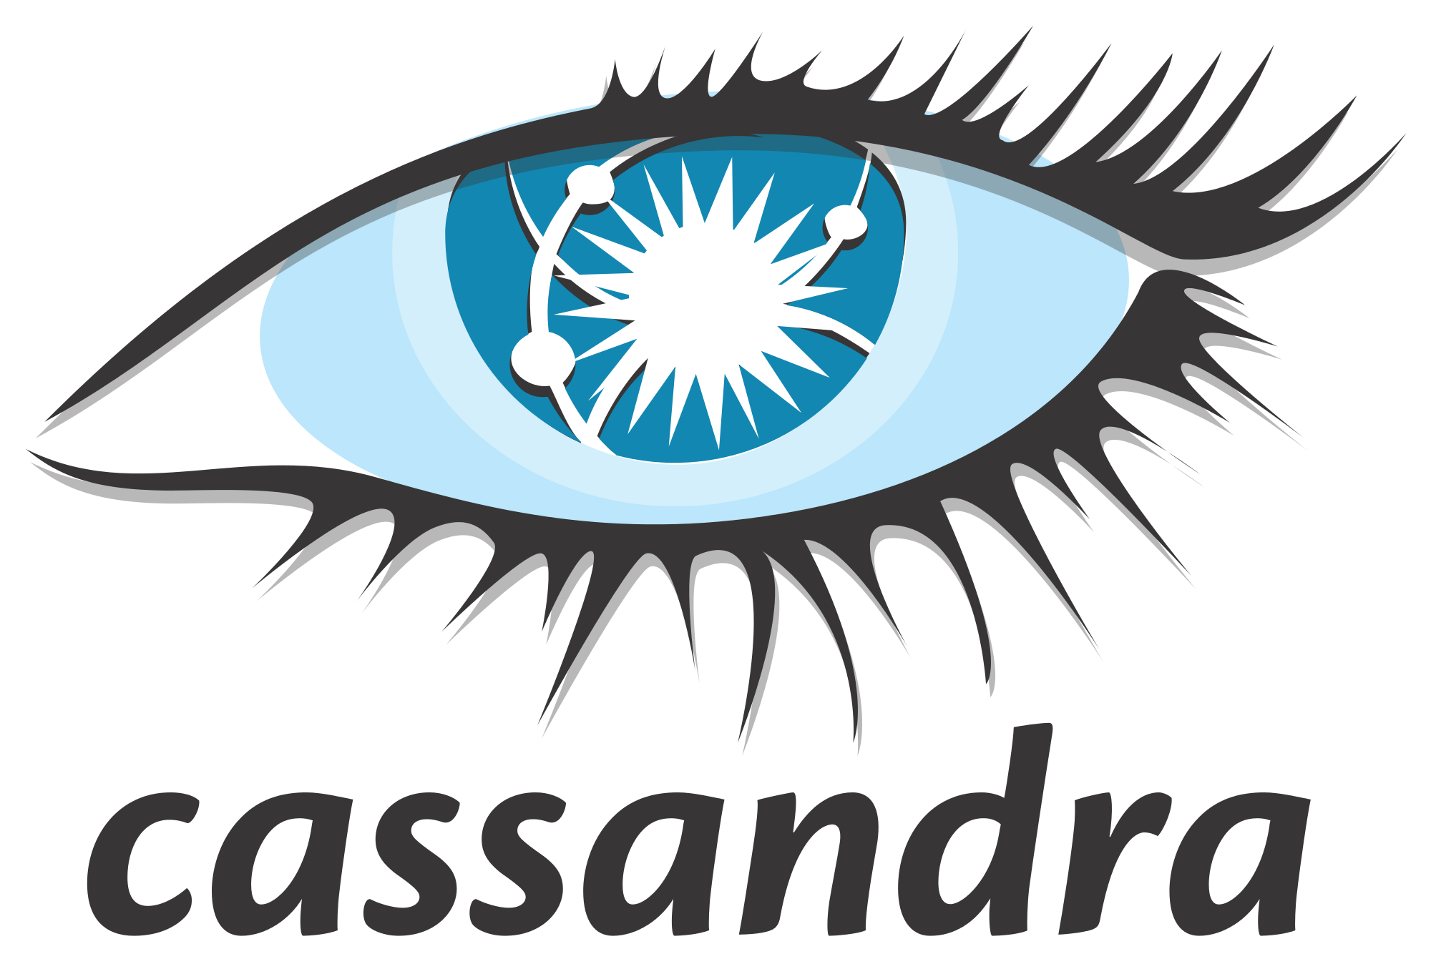









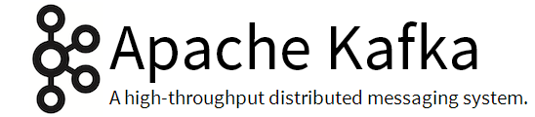










Big Data World goes Crazy

Slide 14
And the revolution begins
Some important frameworks that came out to tackle composability and complexity-:
Frameworks tackling velocity and variety

Slide 15
Word Count - Hive SQL
SELECT
word,
count(*) as count
FROM (
SELECT explode ( split ( sentence , “ “ ) ) AS word FROM sentences
) words
GROUP BY word

Slide 16
Word Count - Crunch MR
Pipeline pipeline = new MRPipeline(WordCount.class, getConf());
pipeline
.readTextFile(args[0])
.parallelDo( new DoFn<String, String>() {
public void process(String line, Emitter<String> emitter) {
for (String word : line.split("\\s+")) {
emitter.emit(word);
}
}
}, Writables.strings())
.count()
.writeTextFile(counts, args[1])
.done();
Notes:
Handover to Achal

Slide 17
Paradigm Shift
<OPINION>
Increasingly Functional Over Time
First Generation
(Java)
Second Generation
(scala)
Third Generation
(Clojure)
Transform
Map/Reduce
Spark
Sparkling
Data Flow
Crunch
Scalding
Cascalog
Complex Event Processing
Storm
ScalaStorm
Storm
Messaging
Kafka
Kafka
Kafka
</OPINION>
Notes:
talk about the exp.

Slide 18

Why the paradigm shift
Less ceremony
Notes:
For less ceremony pt., go to Driver class slide.

Slide 19
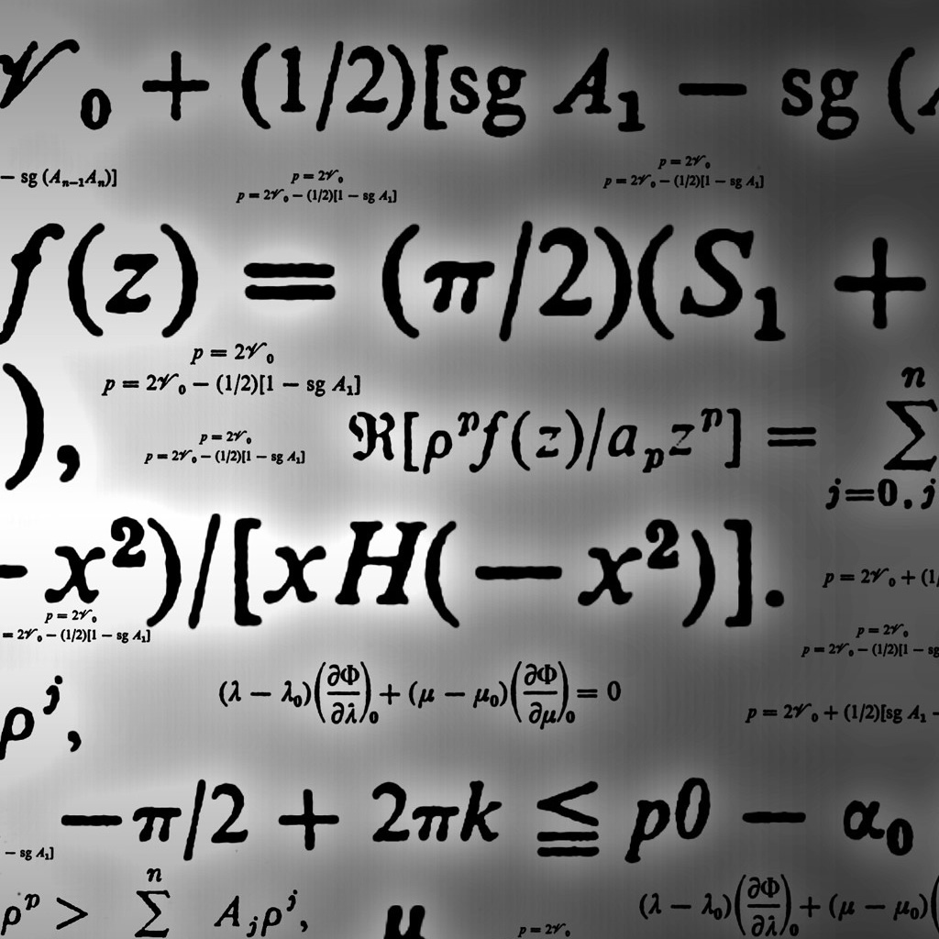
Why the paradigm shift
Functional programming allows you to think of data as mathematical structures
It allows you to think of data as code and code as data.

Slide 20
Why the paradigm shift
Since a functional paradigm forces you to think of your data as an immutable set, transformations can then be extracted and be better thought of and visualized in terms of a pipeline of transformations that act over the dataset compared to typical OO code.
Notes:
Handover to Atif

Slide 21
Why the paradigm shift
Higher order functions offer better levels of abstractions than what can be achieved by typical OO patterns.
x map(h) map(g) map (f)=> f(g(h(x)))
X->
map(h)
map(g)
map(f)
X
h(x)
g(h(x))
f(g(h(x)))

Slide 22
Benefits of Functional Programming
The functional paradigm is naturally suited for-:
1.Parallelism
2.Immutability
3.Laziness
4.Collections and sets

Slide 23




Functional Programming
Functions are “first-class citizens” and can be used anywhere in the code
Function can be an argument to another function – or returned as a result from a function
No side effects
Avoid changing state and avoid mutable data
What to do, not how to do it
First-class functions
Pure functions
Declarative
(vs Imperative)
Immutability
Notes:
Show of hands

Slide 24
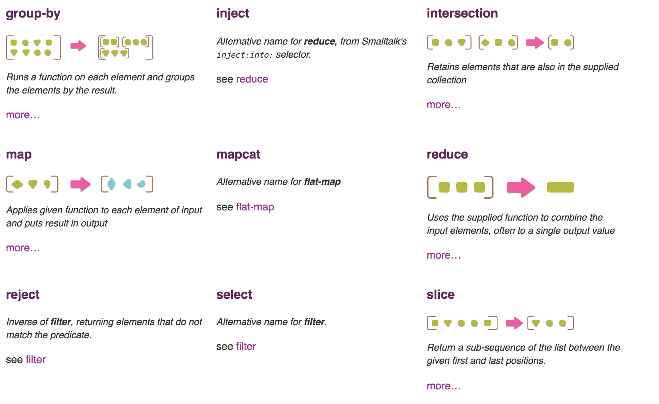
Common Functional Operations
Source: Martin Fowler,ThoughtWorks,Pipeline Collections

Slide 25
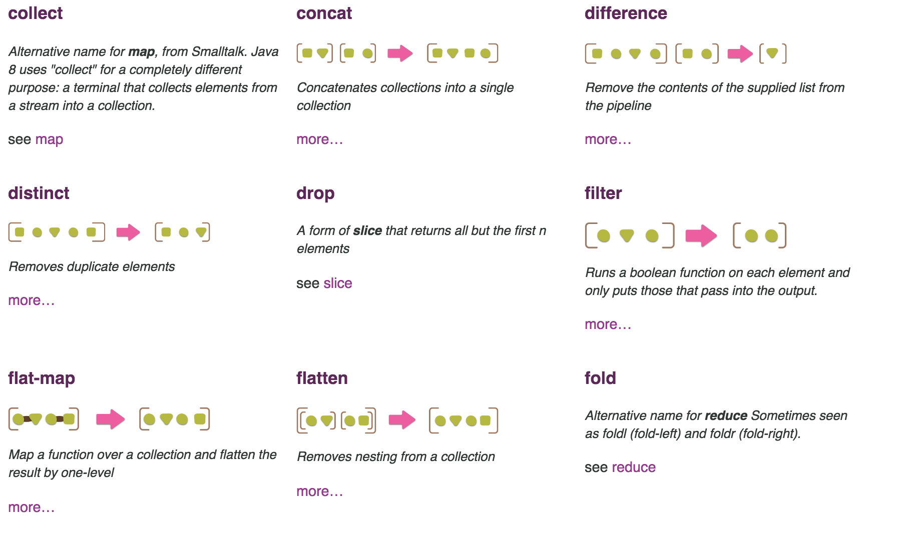
Common Functional Operations
Source: Martin Fowler,ThoughtWorks,Pipeline Collections

Slide 26
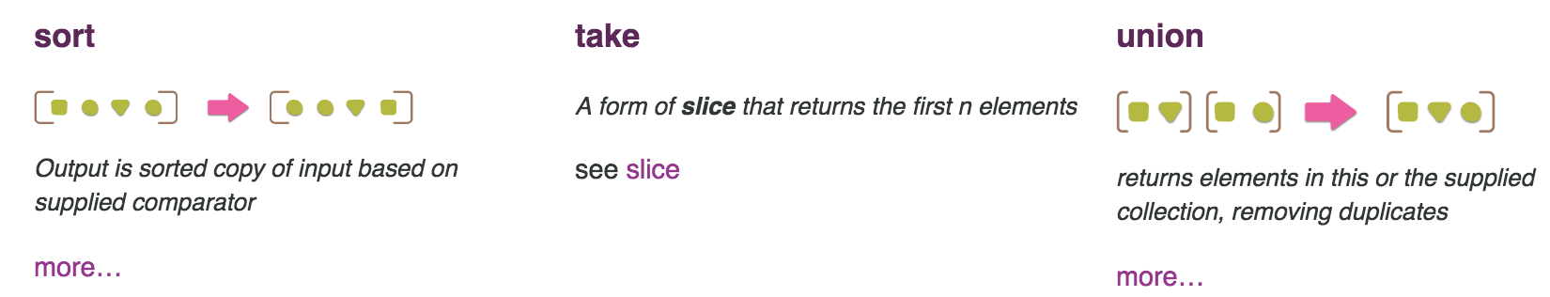
Common Functional Operations
Source: Martin Fowler,ThoughtWorks,Pipeline Collections
Notes:
Handover to Atif

Slide 27
Word Count in Scala
val someListOfSentences = List(
"The quick brown fox jumps over the lazy dog",
"The dog bites",
"There is no spoon"
)
someListOfSentences .flatMap(sentence => sentence.toLowerCase.split(" ")) .map (word => (word -> 1)) .foldLeft(Map.empty[String, Int]){ (countMap, word) => countMap + (word._1->(word._2 + countMap.getOrElse(word._1,0))) }

Slide 28
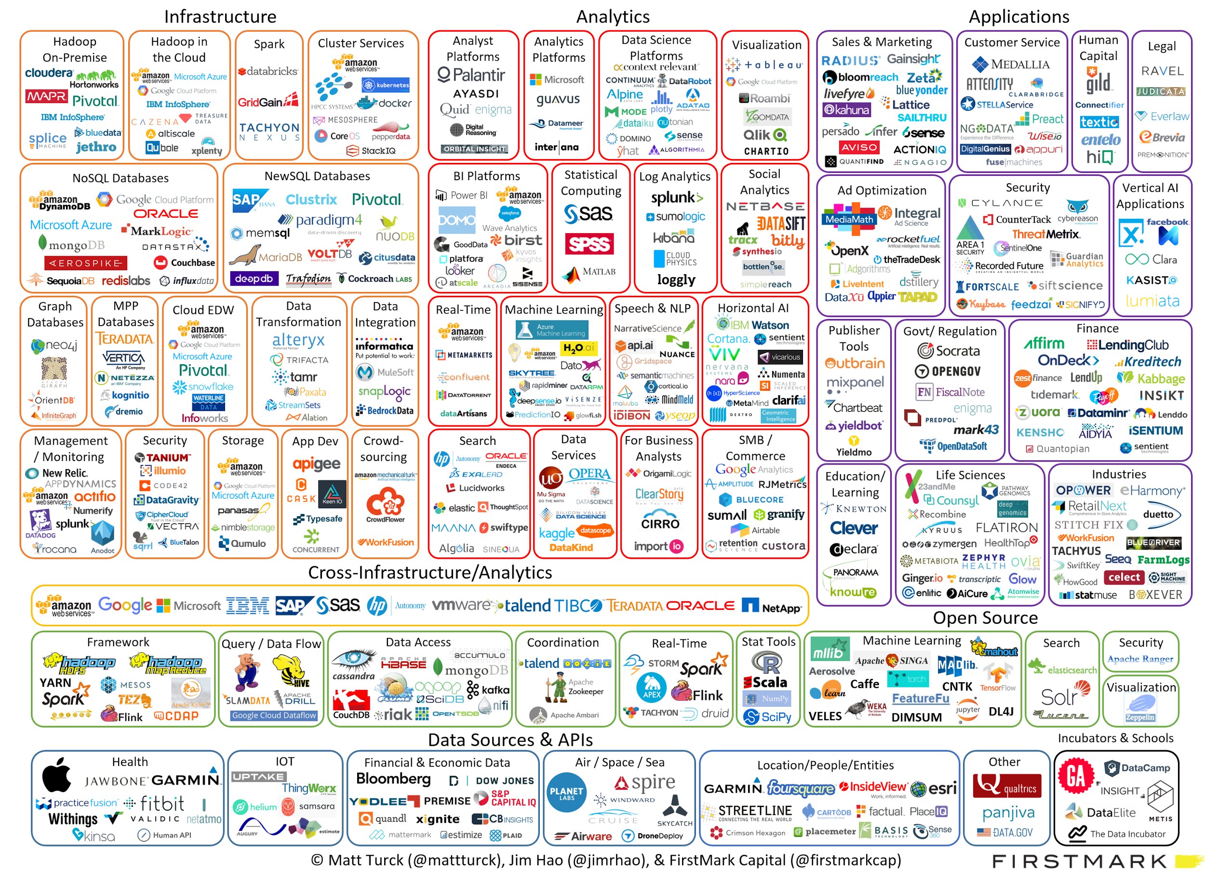
Big Data World goes Crazy
Notes:
bakar

Slide 29
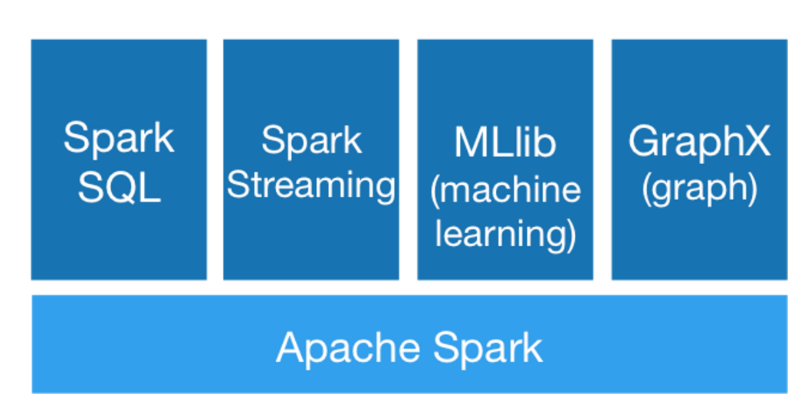
Spark to the Rescue
Apache Spark™ is a fast and general engine for large-scale data processing.
Notes:
Spark - Drop In
Spark tries to combine best of all worlds.

Slide 30
Spark to the Rescue
SPEED
Run programs up to 100x faster than Hadoop MapReduce in memory, or 10x faster on disk.
Spark has an advanced DAG execution engine that supports cyclic data flow and in-memory computing.
EASY OF USE
Write applications quickly in Java, Scala, Python, R.
Spark offers over 80 high-level operators that make it easy to build parallel apps. And you can use it interactively from the Scala, Python and R shells.

Slide 31
Spark to the Rescue
GENERALITY
Combine SQL, streaming, and complex analytics.
Spark powers a stack of libraries including SQL and DataFrames, MLlib for machine learning, GraphX, and Spark Streaming. You can combine these libraries seamlessly in the same application.
RUNS EVERYWHERE
Spark runs on Hadoop, Mesos, standalone, or in the cloud. It can access diverse data sources including HDFS, Cassandra, HBase, and S3.
You can run Spark using its standalone cluster mode, on EC2, on Hadoop YARN, or on Apache Mesos. Access data in HDFS, Cassandra, HBase, Hive, Tachyon, and any Hadoop data source.

Slide 32
Other advantages of Spark
Functional out of the box - Runs on Scala,extends the Scala collections API, offers a natural feeling API
Bundles Streaming, SQL along with Core
Optimization of MR jobs by DAGScheduler
In Memory as much as possible
Integrates seamlessly with a lot already existing big data frameworks and other popular frameworks (HDFS,YARN,Mesos,S3,Kafka)
Can be written in Scala,R,Python,Java
Notes:
How does in Memory improve HDFS
JRuby,CLJR

Slide 33
Demo Time
Spark Core
Spark SQL
Spark Streaming
Notes:
Handover to Achal

Slide 34
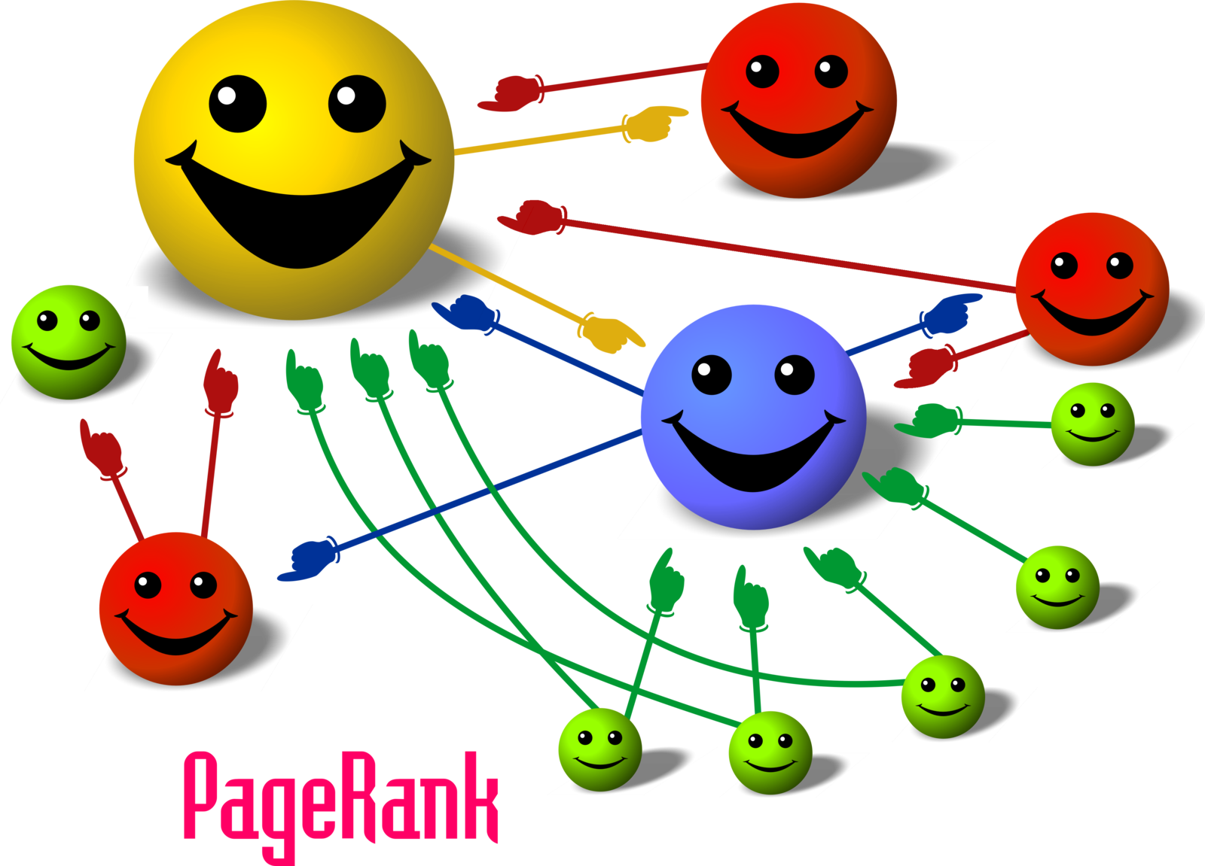
PageRank
Source: en.wikipedia.org/wiki/File:PageRank-hi-res-2.png
Notes:
big data history
Hadoop
functional
spark

Slide 35
PageRank - Basic Idea
Give pages ranks (scores) based on links to them
Links from many pages => high rank
Link from a high-rank page high rank
Notes:
big data history
Hadoop
functional
spark

Slide 36
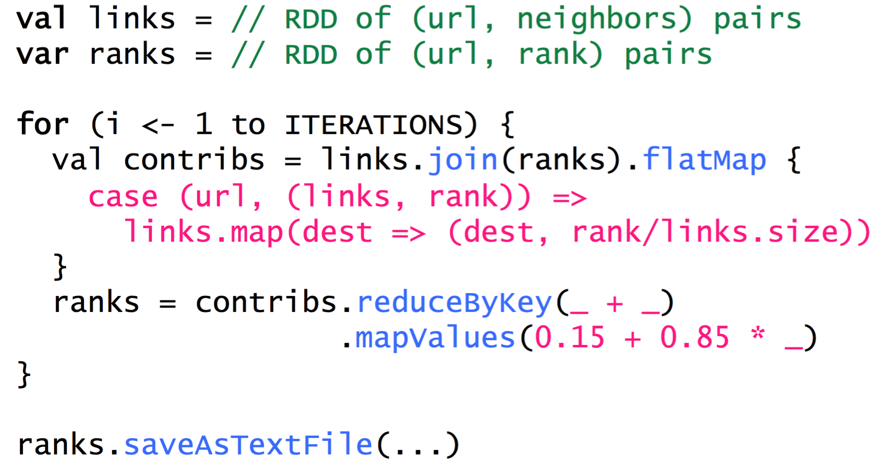
PageRank - Demo
Source : http://ampcamp.berkeley.edu/

Slide 37

Back to the Future

Slide 38
Future Big Data Trends
Big data specific languages such as Julia
Third party domain systems on top of current ecosystem - (Adam)
Mixture of CPU-GPU big data computes (HeteroSpark)
Better visualization tools for Data Analysts and BAs(Zeppelin)
Faster results over data accuracy (Blink DB)
Machine Learning/IoT

Slide 39

THANK YOU

